Slide 1
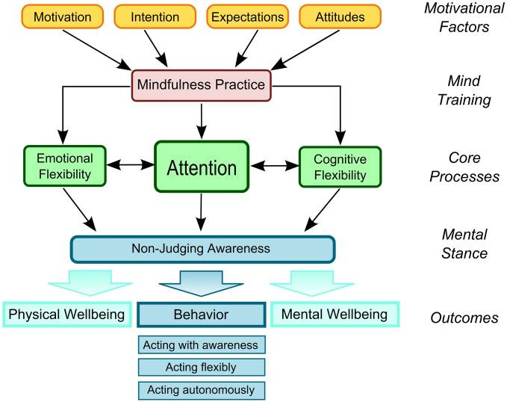
The Association between Race and Mindfulness in a Sample Primed for Stereotype Threat
Adeline Leόn, MSW
BACKGROUND
RESULTS
It is widely known that race and ethnicity are factors associated with performance differences on cognitive tasks, with Caucasians outperforming minorities.
One possible explanation for these performance differences is “stereotype threat,” which inhibits performance due to the individual’s association with a group believed to underperform on the task at hand (Steele & Aronson, 1995).
Awareness of this stereotype leads to a perceived psychological threat, with poor performance viewed as evidence that the individual retains the group’s perceived shortcomings (Martens et al, 2006).
The Liverpool Mindfulness Model (Malinowski, 2013; see Figure 1) demonstrates that attentional training reinforces emotional and cognitive flexibility, which highlights the ability to maintain a non-judgmental awareness toward internal and external experiences (Malinowski, 2013).
This study explored the relationship between mindfulness, measured by the Toronto Mindfulness Scale (TMS), and race in a sample of women primed for stereotype threat while completing the Mental Rotation Test-3D (MRT-3D; Peters et al., 1995), a spatial reasoning task (see Figure 2).
An independent samples t-test revealed a significant relationship between race (Caucasian or non-Caucasian) and scores on the decentering and total scales of the TMS, with higher scores for Caucasians than non-Caucasians.
Figure 1: Liverpool Mindfulness Model (Malinowski, 2013)
Group Statistics and t-scores for TMS scores by race
 | Total (N=128) | Caucasian (N=84) | Non-Caucasian (N=44) | t score/p-value
TMS- Decentering | 18.7 (5.6) | 19.5 (5.5) | 17.2 (5.5) | 2.24/.03*
TMS- Curiosity | 16.9 (6.3) | 17.5 (6.5) | 15.7 (5.9) | 1.5/.14
TMS- Total | 35.6 (10.8) | 37 (10.7) | 33 (10.7) | 2.0/.04*
Figure 2: Mental Rotation Test-3D (Peters et al., 1995)
* Significant at the .05 level
METHODS
DISCUSSION
Data were analyzed for 128 women who participated in an online study regarding mindfulness and its effect on spatial reasoning performance.
Participants were recruited through an online ad that contained a link to www.qualtrics.com, the online data collection tool.
Exclusion criteria included being male or under the age of 18.
After consenting to the study, participants were asked a primer question (“Are you aware of the stereotype which claims that females do not perform as well on spatial reasoning tasks as males do?”) to elicit the stereotype threat effect.
Participants completed the demographics questionnaire, MRT, and the TMS.
A debriefing form was presented to participants, who were given the option of providing an e-mail address to be entered in a raffle to win one of four $50 Amazon gift cards.
Overall, there appears to be a significant association between race and mindfulness when minorities are primed for stereotype threat, suggesting that increased mindfulness may be beneficial for minorities when completing these cognitive tasks.
Using the fundamental elements found in this study, future research may contribute to the literature on this topic, and perhaps lead to more valuable interventions to overcome the effects of stereotype threat in women and ethnic minorities.
REFERENCES
Malinowski, P. (2013). Neural mechanisms of attentional control in mindfulness meditation. Frontiers in Neuroscience, 04,
February, 2013. doi: 10.3389/fnins.2013.00008
Martens, A., Johns, M., Greenberg, J., & Schimel, J. (2006). Combating stereotype threat: The effect of self-affirmation on women’s intellectual performance. Journal of Experimental Social Psychology, 42(2), 236-243.
Peters, M., Laeng, B., Latham, K., Jackson, M., Zaiyouna, R. & Richardson, C. (1995). A redrawn Vandenberg & Kuse mental
rotations test: different versions and factors that affect performance. Brain and Cognition, 28, 39-58.
Steele, C. & Aronson, J. (1995). Stereotype threat and the intellectual test performance of African Americans. Journal of
Personality and Social Psychology 69(5): 797-811. doi: 10.1037/0022-3514.69.5.797

